Slide 1
Digital Design & Computer Arch. Lecture 4: Combinational Logic I
Prof. Onur Mutlu
ETH Zürich
Spring 2020
28 February 2020

Slide 2
Assignment: Required Readings
This week
Combinational Logic
P&P Chapter 3 until 3.3 + H&H Chapter 2
Next week
Hardware Description Languages and Verilog
H&H Chapter 4 until 4.3 and 4.5
Sequential Logic
P&P Chapter 3.4 until end + H&H Chapter 3 in full
By the end of next week, make sure you are done with
P&P Chapters 1-3 + H&H Chapters 1-4

Slide 3
A Note on Hardware vs. Software
This course might seem like it is only “Computer Hardware”
However, you will be much more capable if you master both hardware and software (and the interface between them)
Can develop better software if you understand the hardware
Can design better hardware if you understand the software
Can design a better computing system if you understand both
This course covers the HW/SW interface and microarchitecture
We will focus on tradeoffs and how they affect software
Recall the four mysteries

Slide 4
Recap: Four Mysteries
Meltdown & Spectre (2017-2018)
Rowhammer (2012-2014)
Memory Performance Attacks (2006-2007)
Memories Forget: Refresh & RAIDR (2011-2012)

Slide 5
Computer Architecture as an Enabler of the Future

Slide 6
Assignment: Required Lecture Video
Why study computer architecture?
Why is it important?
Future Computing Architectures
Required Assignment
Watch Prof. Mutlu’s inaugural lecture at ETH and understand it
https://www.youtube.com/watch?v=kgiZlSOcGFM
Optional Assignment – for 1% extra credit
Write a 1-page summary of the lecture and email us
What are your key takeaways?
What did you learn?
What did you like or dislike?
Submit your summary to Moodle – Deadline: April 1

Slide 7
… but, first …
Let’s understand the fundamentals…
You can change the world only if you understand it well enough…
Especially the basics (fundamentals)
Past and present dominant paradigms
And, their advantages and shortcomings – tradeoffs
And, what remains fundamental across generations
And, what techniques you can use and develop to solve problems

Slide 8
Fundamental Concepts

Slide 9
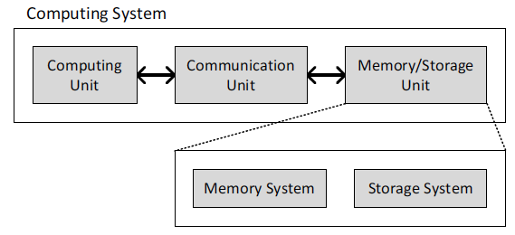
What is A Computer?
Three key components
Computation
Communication
Storage/memory
Burks, Goldstein, von Neumann, “Preliminary discussion of the
logical design of an electronic computing instrument,” 1946.
Image source: https://lbsitbytes2010.wordpress.com/2013/03/29/john-von-neumann-roll-no-15/

Slide 10
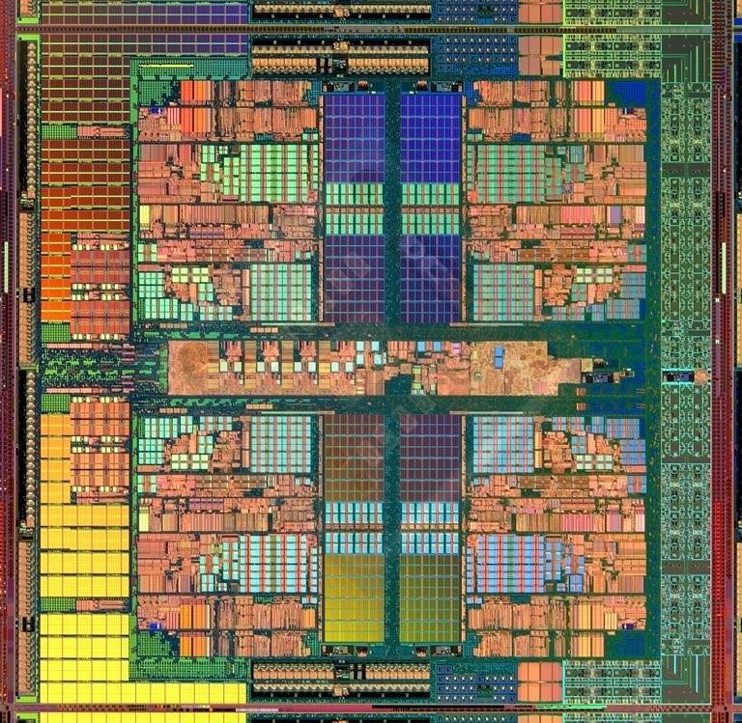
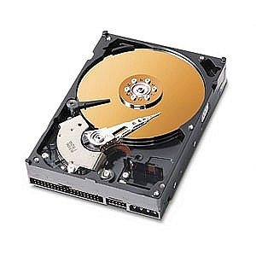
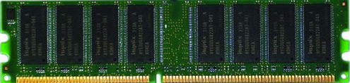
What is A Computer?
Three key components
Computation
Communication
Storage/memory
Burks, Goldstein, von Neumann, “Preliminary discussion of the
logical design of an electronic computing instrument,” 1946.
Image source: https://lbsitbytes2010.wordpress.com/2013/03/29/john-von-neumann-roll-no-15/

Slide 11
What is A Computer?
We will cover all three components
Processing
Memory
(program
and data)
I/O
control
(sequencing)
datapath

Slide 12
Recall: The Transformation Hierarchy
Problem
Algorithm
Program/Language
System Software
Computer Architecture (expanded view)
SW/HW Interface
Computer Architecture (narrow view)
Micro-architecture
Logic
Devices
Electrons

Slide 13
What We Will Cover (I)
Combinational Logic Design
Hardware Description Languages (Verilog)
Sequential Logic Design
Timing and Verification
ISA (MIPS and LC3b)
MIPS Assembly Programming
Problem
Algorithm
Program/Language
System Software
SW/HW Interface
Micro-architecture
Logic
Devices
Electrons

Slide 14
What We Will Cover (II)
Microarchitecture Basics: Single-cycle
Multi-cycle and Microprogrammed Microarchitectures
Pipelining
Issues in Pipelining: Control & Data Dependence Handling, State Maintenance and Recovery, …
Out-of-Order Execution
Other Processing Paradigms (SIMD, VLIW, Systolic, …)
Memory and Caches
Virtual Memory

Slide 15
Processing Paradigms We Will Cover
Pipelining
Out-of-order execution
Dataflow (at the ISA level)
Superscalar Execution
VLIW
SIMD Processing (Vector & array, GPUs)
Decoupled Access Execute
Systolic Arrays
Problem
Algorithm
Program/Language
System Software
SW/HW Interface
Micro-architecture
Logic
Devices
Electrons

Slide 16
Combinational Logic Circuits and Design

Slide 17
What Will We Learn Today?
Building blocks of modern computers
Transistors
Logic gates
Boolean algebra
Combinational circuits
How to use Boolean algebra to represent combinational circuits
Minimizing logic circuits (if time permits)

Slide 18
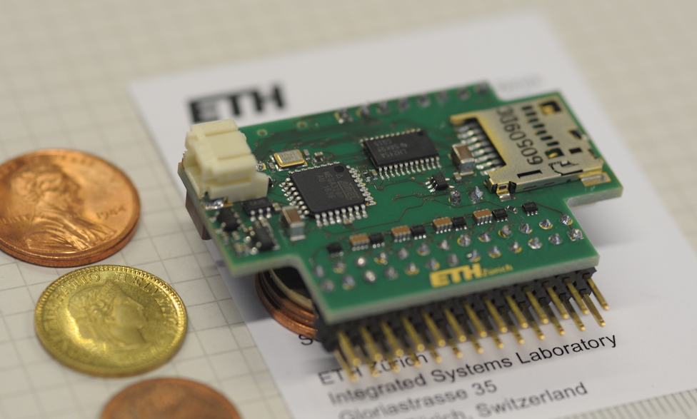
(Micro)-Processors

Slide 19
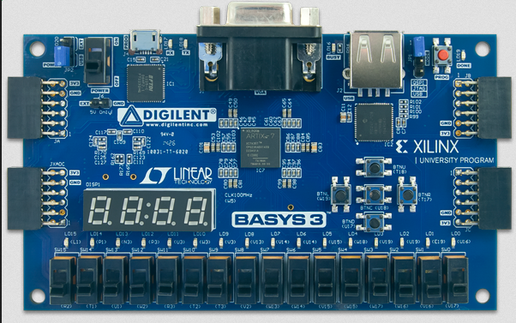
FPGAs

Slide 20
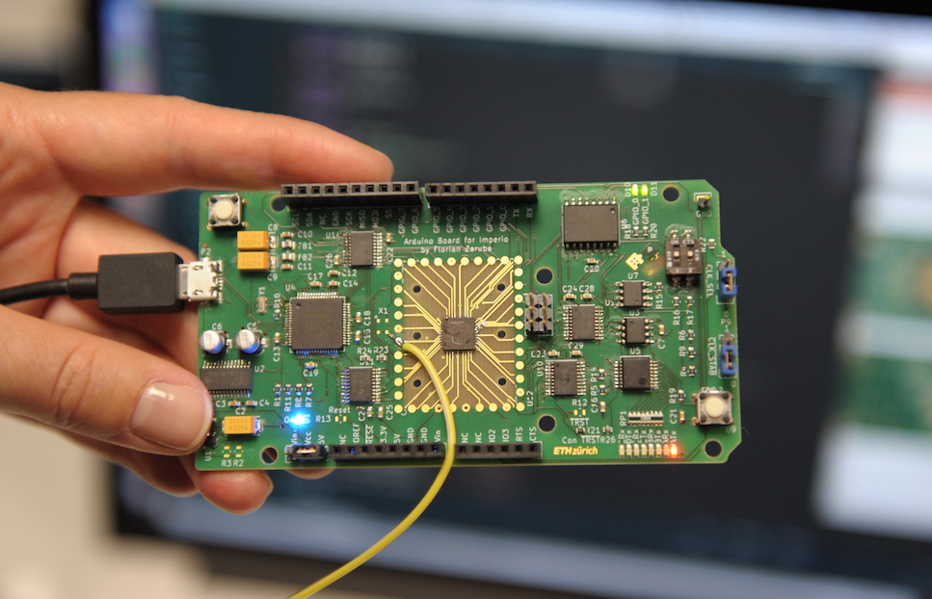
Custom ASICs

Slide 21
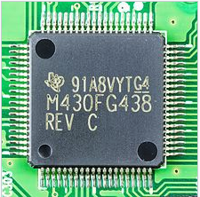
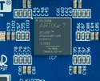
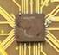
They All Look the Same
 | Microprocessors | FPGAs | ASICs
In short: | Common building block of computers | Reconfigurable hardware, flexible | You customize everything

Slide 22
They All Look the Same
 | Microprocessors | FPGAs | ASICs
In short: | Common building block of computers | Reconfigurable hardware, flexible | You customize everything
Program Development Time | minutes | days | months

Slide 23
They All Look the Same
 | Microprocessors | FPGAs | ASICs
In short: | Common building block of computers | Reconfigurable hardware, flexible | You customize everything
Program Development Time | minutes | days | months
Performance | o | + | ++

Slide 24
They All Look the Same
 | Microprocessors | FPGAs | ASICs
In short: | Common building block of computers | Reconfigurable hardware, flexible | You customize everything
Program Development Time | minutes | days | months
Performance | o | + | ++
Good for | Ubiquitous Simple to use | Prototyping Small volume | Mass production, Max performance

Slide 25
They All Look the Same
 | Microprocessors | FPGAs | ASICs
In short: | Common building block of computers | Reconfigurable hardware, flexible | You customize everything
Program Development Time | minutes | days | months
Performance | o | + | ++
Good for | Ubiquitous Simple to use | Prototyping Small volume | Mass production, Max performance
Programming | Executable file | Bit file | Design masks
Languages | C/C++/Java/… | Verilog/VHDL | Verilog/VHDL
Main Companies | Intel, ARM, AMD | Xilinx, Altera, Lattice | TSMC, UMC, ST, Globalfoundries

Slide 26
They All Look the Same
Want to learn how these work
By programming these
 | Microprocessors | FPGAs | ASICs
In short: | Common building block of computers | Reconfigurable hardware, flexible | You customize everything
Program Development Time | minutes | days | months
Performance | o | + | ++
Good for | Ubiquitous Simple to use | Prototyping Small volume | Mass production, Max performance
Programming | Executable file | Bit file | Design masks
Languages | C/C++/Java/… | Verilog/VHDL | Verilog/VHDL
Main Companies | Intel, ARM, AMD | Xilinx, Altera, Lattice | TSMC, UMC, ST, Globalfoundries
Using this language

Slide 27
Building Blocks of Modern Computers

Slide 28
Transistors

Slide 29
Transistors
Computers are built from very large numbers of very simple structures
Intel’s Pentium IV microprocessor, first offered for sale in 2000, was made up of more than 42 million MOS transistors
Intel’s Core i7 Broadwell-E, offered for sale in 2016, is made up of more than 3.2 billion MOS transistors
This lecture
How the MOS transistor works (as a logic element)
How these transistors are connected to form logic gates
Problem
Algorithm
Program/Language
Runtime System
(VM, OS, MM)
ISA (Architecture)
Microarchitecture
Logic
Devices
Electrons
How logic gates are interconnected to form larger units that are needed to construct a computer

Slide 30
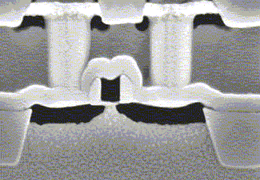
MOS Transistor
By combining
Conductors (Metal)
Insulators (Oxide)
Semiconductors
We get a Transistor (MOS)
Why is this useful?
We can combine many of these to realize simple logic gates
The electrical properties of metal-oxide semiconductors are well beyond the scope of what we want to understand in this course
They are below our lowest level of abstraction
Gate
Source
Drain

Slide 31
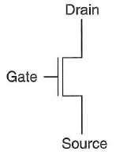
Different Types of MOS Transistors
There are two types of MOS transistors: n-type and p-type
They both operate “logically,” very similar to the way wall switches work
n-type
p-type

Slide 32
How Does a Transistor Work?
In order for the lamp to glow, electrons must flow
In order for electrons to flow, there must be a closed circuit from the power supply to the lamp and back to the power supply
The lamp can be turned on and off by simply manipulating the wall switch to make or break the closed circuit

Slide 33
How Does a Transistor Work?
Instead of the wall switch, we could use an n-type or a p-type MOS transistor to make or break the closed circuit
If the gate of an n-type transistor is supplied with a high voltage, the connection from source to drain acts like a piece of wire
If the gate of an n-type transistor is supplied with a high voltage, the connection from source to drain acts like a piece of wire
Depending on the technology, 0.3V to 3V
Schematic of an n-type
MOS transistor
If the gate of the n-type transistor is supplied with 0V, the connection between the source and drain is broken

Slide 34
How Does a Transistor Work?
The n-type transistor in a circuit with a battery and a bulb
The p-type transistor works in exactly the opposite fashion from the n-type transistor
Shorthand notation
The circuit is closed when the gate is supplied with 3V
The circuit is closed when the gate is supplied with 0V
n-type
p-type

Slide 35
Logic Gates

Slide 36
One Level Higher in the Abstraction
Now, we know how a MOS transistor works
How do we build logic out of MOS transistors?
We construct basic logic structures out of individual MOS transistors
These logical units are named logic gates
They implement simple Boolean functions
Problem
Algorithm
Program/Language
Runtime System
(VM, OS, MM)
ISA (Architecture)
Microarchitecture
Logic
Devices
Electrons

Slide 37
Making Logic Blocks Using CMOS Technology
Modern computers use both n-type and p-type transistors, i.e. Complementary MOS (CMOS) technology
The simplest logic structure that exists in a modern computer
nMOS + pMOS = CMOS
p-type
What does this circuit do?
n-type
Notes:
N-type transistors pass 0’s well, but 1’s poorly
P-type transistors pass 1’s well, but 0’s poorly
That is why they are connected to the 3V and GND the way they are connected.
N-type’s source is connected to 0
P-type’s source is connected to 3V

Slide 38
Functionality of Our CMOS Circuit
What happens when the input is connected to 0V?
p-type transistor pulls the output up
Notes:
N-type transistors pass 0’s well, but 1’s poorly
P-type transistors pass 1’s well, but 0’s poorly
That is why they are connected to the 3V and GND the way they are connected.
N-type’s source is connected to 0
P-type’s source is connected to 3V

Slide 39
Functionality of Our CMOS Circuit
What happens when the input is connected to 3V?
n-type transistor pulls the output down
Notes:
N-type transistors pass 0’s well, but 1’s poorly
P-type transistors pass 1’s well, but 0’s poorly
That is why they are connected to the 3V and GND the way they are connected.
N-type’s source is connected to 0
P-type’s source is connected to 3V

Slide 40
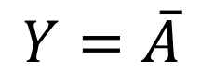
CMOS NOT Gate
This is actually the CMOS NOT Gate
Why do we call it NOT?
If A = 0V then Y = 3V
If A = 3V then Y = 0V
Digital circuit: one possible interpretation
Interpret 0V as logical (binary) 0 value
Interpret 3V as logical (binary) 1 value
A | P | N | Y
0
1
A | P | N | Y
0 | ON | OFF | 1
1
A | P | N | Y
0 | ON | OFF | 1
1 | OFF | ON | 0
$$Y=\overline{A}$$

Slide 41
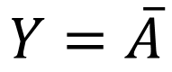
CMOS NOT Gate
This is actually the CMOS NOT Gate
Why do we call it NOT?
If A = 0V then Y = 3V
If A = 3V then Y = 0V
Digital circuit: one possible interpretation
Interpret 0V as logical (binary) 0 value
Interpret 3V as logical (binary) 1 value
$$Y=\overline{A}$$
Truth table: what would be the logical output of the circuit for each possible input
We call it a NOT gate
or an inverter
Notes:
N-type transistors pass 0’s well, but 1’s poorly
P-type transistors pass 1’s well, but 0’s poorly
That is why they are connected to the 3V and GND the way they are connected.
N-type’s source is connected to 0
P-type’s source is connected to 3V

Slide 42
Another CMOS Gate: What Is This?
Let’s build more complex gates!

Slide 43
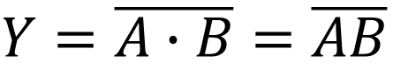
CMOS NAND Gate
Let’s build more complex gates!
P1 and P2 are in parallel; only one must be ON to pull the output up to 3V
N1 and N2 are connected in series; both must be ON to pull the output to 0V
$Y=\overline{A∙B}=$ $\overline{AB}$
A | B | P1 | P2 | N1 | N2 | Y
0 | 0
0 | 1
1 | 0
1 | 1
A | B | P1 | P2 | N1 | N2 | Y
0 | 0 | ON | ON | OFF | OFF | 1
0 | 1
1 | 0
1 | 1
A | B | P1 | P2 | N1 | N2 | Y
0 | 0 | ON | ON | OFF | OFF | 1
0 | 1 | ON | OFF | OFF | ON | 1
1 | 0
1 | 1
A | B | P1 | P2 | N1 | N2 | Y
0 | 0 | ON | ON | OFF | OFF | 1
0 | 1 | ON | OFF | OFF | ON | 1
1 | 0 | OFF | ON | ON | OFF | 1
1 | 1
A | B | P1 | P2 | N1 | N2 | Y
0 | 0 | ON | ON | OFF | OFF | 1
0 | 1 | ON | OFF | OFF | ON | 1
1 | 0 | OFF | ON | ON | OFF | 1
1 | 1 | OFF | OFF | ON | ON | 0

Slide 44
CMOS NAND Gate
Let’s build more complex gates!
$Y=\overline{A∙B}=$ $\overline{AB}$

Slide 45
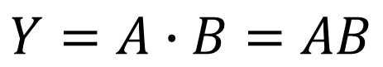
CMOS AND Gate
How can we make an AND gate?
$$Y=A∙B=AB$$
We make an AND gate using
one NAND gate and
one NOT gate

Slide 46
CMOS NOT, NAND, AND Gates

Slide 47
General CMOS Gate Structure
The general form used to construct any inverting logic gate, such as: NOT, NAND, or NOR
The networks may consist of transistors in series or in parallel
When transistors are in parallel, the network is ON if one of the transistors is ON
When transistors are in series, the network is ON only if all transistors are ON
pMOS transistors are used for pull-up
nMOS transistors are used for pull-down
Notes:
N-type transistors pass 0’s well, but 1’s poorly
P-type transistors pass 1’s well, but 0’s poorly
That is why they are connected to the 3V and GND the way they are connected.
N-type’s source is connected to 0
P-type’s source is connected to 3V

Slide 48
General CMOS Gate Structure (II)
Exactly one network should be ON, and the other network should be OFF at any given time
If both networks are ON at the same time, there is a short circuit → likely incorrect operation
If both networks are OFF at the same time, the output is floating → undefined
pMOS transistors are used for pull-up
nMOS transistors are used for pull-down
Notes:
N-type transistors pass 0’s well, but 1’s poorly
P-type transistors pass 1’s well, but 0’s poorly
That is why they are connected to the 3V and GND the way they are connected.
N-type’s source is connected to 0
P-type’s source is connected to 3V

Slide 49
Digging Deeper: Why This Structure?
MOS transistors are not perfect switches
pMOS transistors pass 1’s well but 0’s poorly
nMOS transistors pass 0’s well but 1’s poorly
pMOS transistors are good at “pulling up” the output
nMOS transistors are good at “pulling down” the output
See Section 1.7 in H&H

Slide 50
Digging Deeper: Latency
Which one is faster?
Transistors in series
Transistors in parallel
Series connections are slower than parallel connections
More resistance on the wire
How do you alleviate this latency?
See H&H Section 1.7.8 for an example: pseudo-nMOS Logic

Slide 51
Digging Deeper: Power Consumption
Dynamic Power Consumption
C * V² * f
C = capacitance of the circuit (wires and gates)
V = supply voltage
f = charging frequency of the capacitor
Static Power consumption
V * I_{leakage}
supply voltage * leakage current
Energy Consumption
Power * Time
See more in H&H Chapter 1.8

Slide 52
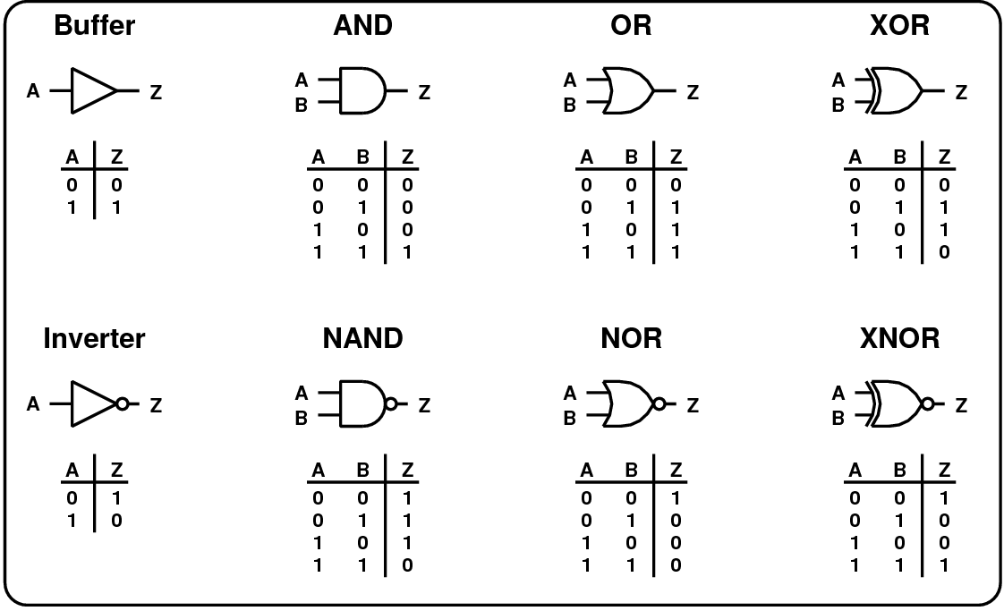
Common Logic Gates

Slide 53
Larger Gates
We can extend the gates to more than 2 inputs
Example: 3-input AND gate, 10-input NOR gate
See your readings

Slide 54
Aside: Moore’s Law: Enabler of Many Gates on a Chip

Slide 55
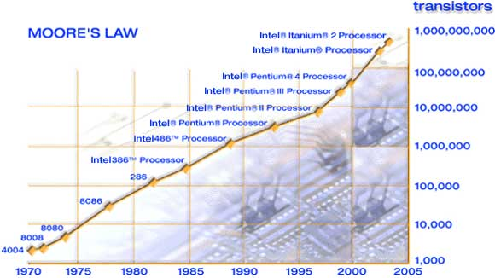
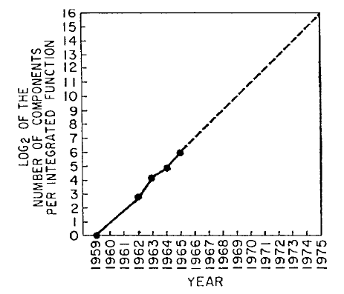
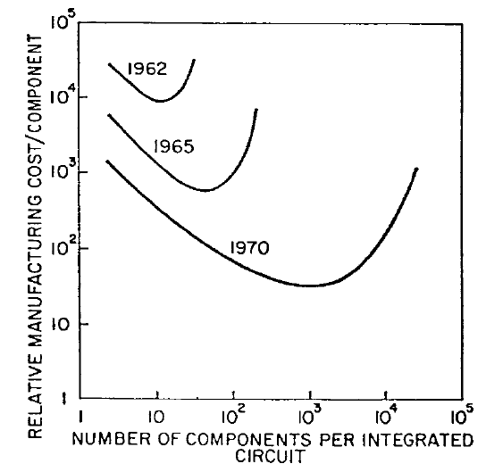
An Enabler: Moore’s Law
Moore, “Cramming more components onto integrated circuits,”
Electronics Magazine, 1965. Component counts double every other year
Image source: Intel

Slide 56
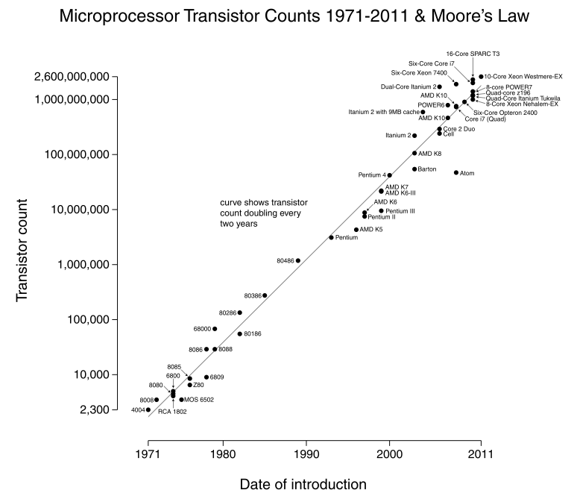
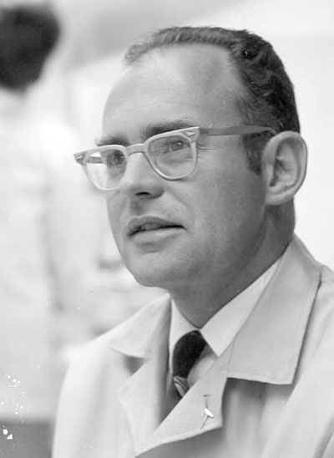
Number of transistors on an integrated circuit doubles ~ every two years
Image source: Wikipedia

Slide 57
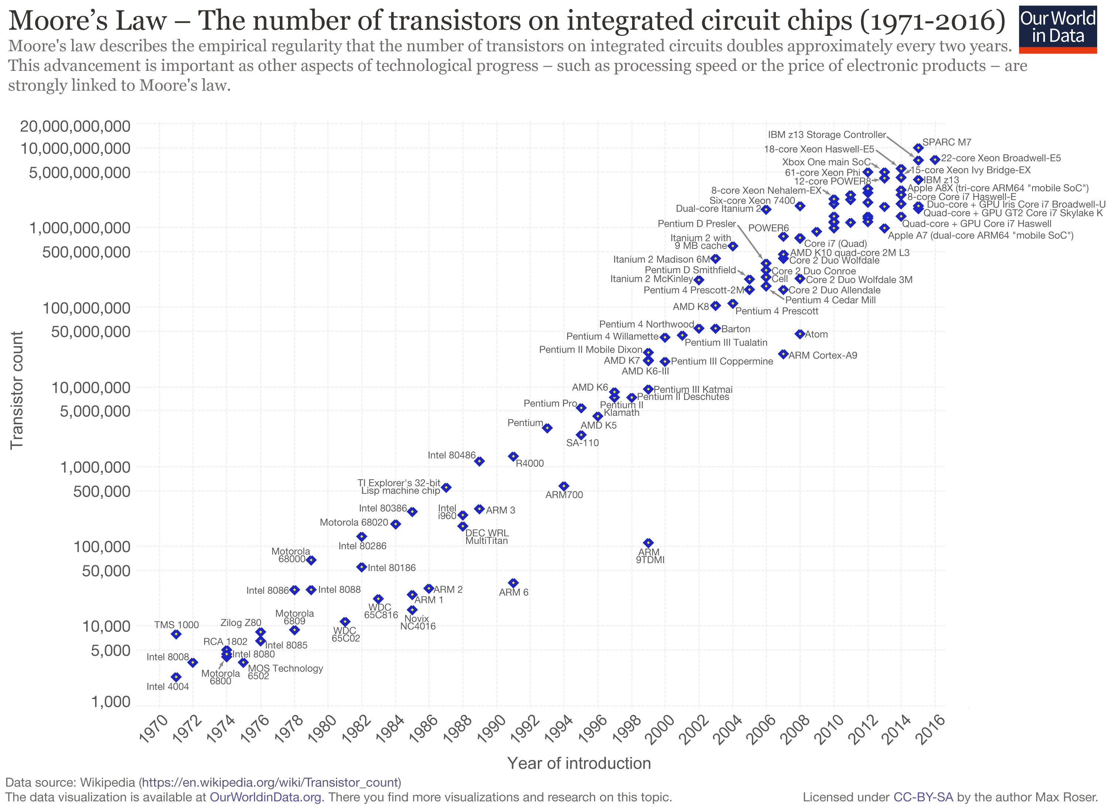

Slide 58
Recommended Reading
Moore, “Cramming more components onto integrated circuits,” Electronics Magazine, 1965.
Only 3 pages
A quote:
“With unit cost falling as the number of components per circuit rises, by 1975 economics may dictate squeezing as many as 65 000 components on a single silicon chip.”
Another quote:
“Will it be possible to remove the heat generated by tens of thousands of components in a single silicon chip?”

Slide 59
How Do We Keep Moore’s Law
Manufacturing smaller transistors/structures
Some structures are already a few atoms in size
Developing materials with better properties
Copper instead of Aluminum (better conductor)
Hafnium Oxide, air for Insulators
Making sure all materials are compatible is the challenge
Optimizing the manufacturing steps
How to use 193nm ultraviolet light to pattern 20nm structures
New technologies
FinFET, Gate All Around transistor, Single Electron Transistor…

Slide 60
Combinational Logic Circuits

Slide 61
We Can Now Build Logic Circuits
Now, we understand the workings of the basic logic gates
What is our next step?
Build some of the logic structures that are important components of the microarchitecture of a computer!
A logic circuit is composed of:
Inputs
Outputs
Functional specification (describes relationship between inputs and outputs)
Timing specification (describes the delay between inputs changing and outputs responding)

Slide 62
Types of Logic Circuits
Combinational Logic
Memoryless
Outputs are strictly dependent on the combination of input values that are being applied to circuit right now
In some books called Combinatorial Logic
Later we will learn: Sequential Logic
Has memory
Structure stores history → Can ”store” data values
Outputs are determined by previous (historical) and current values of inputs

Slide 63
Boolean Equations

Slide 64
Functional Specification
Functional specification of outputs in terms of inputs
What do we mean by “function”?
Unique mapping from input values to output values
The same input values produce the same output value every time
No memory (does not depend on the history of input values)
Example (full 1-bit adder – more later):
S = F(A, B, C_{in})
C_{out} = G(A, B, C_{in})

Slide 65
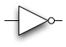
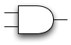
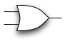
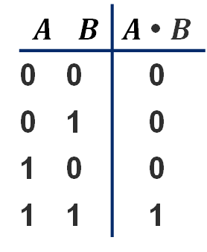
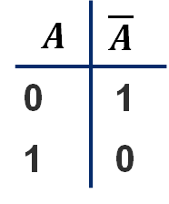

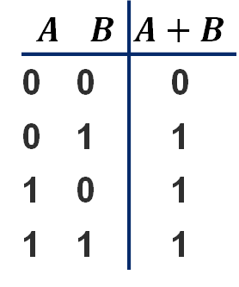
Simple Equations: NOT / AND / OR
$$A$$ | $$\overline{A}$$
0 | 1
1 | 0
$\overline{A}$ (reads “not A”) is 1 iff A is 0
A
$$\overline{A}$$
$$A$$ | $$B$$ | $A$ • $B$
0 | 0 | 0
0 | 1 | 0
1 | 0 | 0
1 | 1 | 1
A • B (reads “A and B”) is 1 iff A and B are both 1
A
A • B
B
$$A$$ | $$B$$ | $A+B$
0 | 0 | 0
0 | 1 | 1
1 | 0 | 1
1 | 1 | 1
A + B (reads “A or B”) is 1 iff either A or B is 1
A
A + B
B

Slide 66
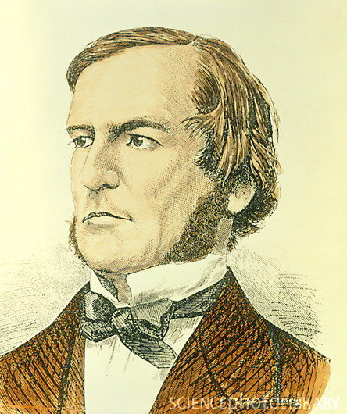
Boolean Algebra: Big Picture
An algebra on 1’s and 0’s
with AND, OR, NOT operations
What you start with
Axioms: basic things about objects and operations you just assume to be true at the start
What you derive first
Laws and theorems: allow you to manipulate Boolean expressions
…also allow us to do some simplification on Boolean expressions
What you derive later
More “sophisticated” properties useful for manipulating digital designs represented in the form of Boolean equations
George Boole, “The Mathematical Analysis of Logic,” 1847.

Slide 67
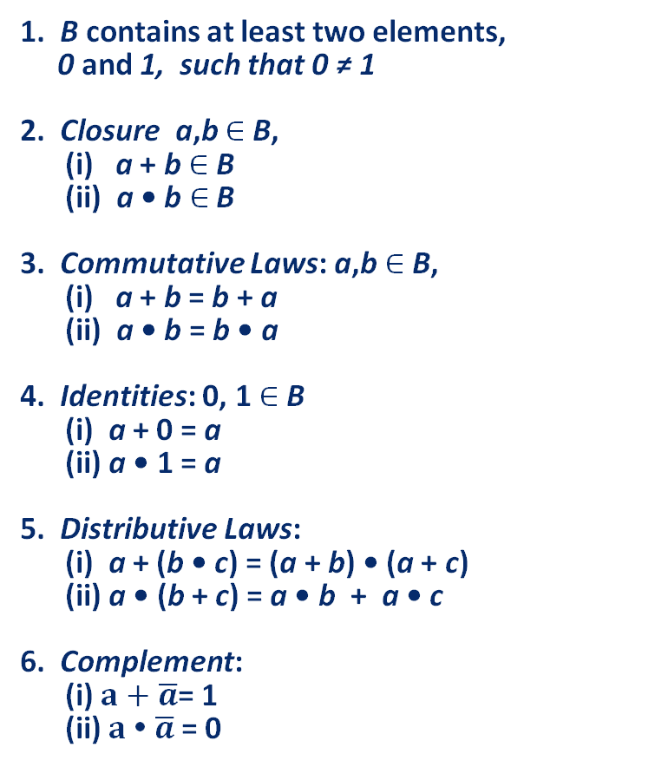
Boolean Algebra: Axioms
Formal version
English version
1. B contains at least two elements,
0 and 1, such that 0 ≠ 1
2. Closure a,b $∈$ B,
(i) a + b $∈$ B
(ii) a • b $∈$ B
3. Commutative Laws: a,b $∈$ B,
(i) a + b = b + a
(ii) a • b = b • a
4. Identities: 0, 1 $∈$ B
(i) a + 0 = a
(ii) a • 1 = a
5. Distributive Laws:
(i) a + (b • c) = (a + b) • (a + c)
(ii) a • (b + c) = a • b + a • c
6. Complement:
(i) $a+\overline{a}$= 1
(ii) $a \text{•} \overline{a}$= 0
Math formality...
Result of AND, OR stays
in set you start with
For primitive AND, OR of
2 inputs, order doesn’t matter
There are identity elements
for AND, OR, that give you back
what you started with
• distributes over +, just like algebra
…but + distributes over •, also (!!)
There is a complement element;
AND/ORing with it gives the identity elm.

Slide 68
Boolean Algebra: Duality
Observation
All the axioms come in “dual” form
Anything true for an expression also true for its dual
So any derivation you could make that is true, can be flipped into dual form, and it stays true
Duality — More formally
A dual of a Boolean expression is derived by replacing
Every AND operation with... an OR operation
Every OR operation with... an AND
Every constant 1 with... a constant 0
Every constant 0 with... a constant 1
But don’t change any of the literals or play with the complements!
Example
a • (b + c) = (a • b) + (a • c)
➙ a + (b • c) = (a + b) • (a + c)

Slide 69


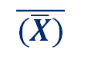
Boolean Algebra: Useful Laws
Dual
Operations with 0 and 1:
Idempotent Law:
Involution Law:
Laws of Complementarity:
Commutative Law:
AND, OR with identities
gives you back the original
variable or the identity
AND, OR with self = self
double complement =
no complement
AND, OR with complement
gives you an identity
Just an axiom…
1. X + 0 = X
2. X + 1 = 1
1D. X • 1 = X
2D. X • 0 = 0
3. X + X = X
3D. X • X = X
$$\overline{(\overline{X})}$$
4. = X
$$\overline{X}$$
$$\overline{X}$$
5. X + = 1
5D. X • = 0
6. X + Y = Y + X
6D. X • Y = Y • X

Slide 70




Useful Laws (cont)
Associative Laws:
7. (X + Y) + Z = X + (Y + Z)
= X + Y + Z
7D. (X • Y) • Z = X • (Y • Z)
= X • Y • Z
Parenthesis order
does not matter
Distributive Laws:
Simplification Theorems:
8. X • (Y+ Z) = (X • Y) + (X • Z)
8D. X + (Y• Z) = (X + Y) • (X + Z)
Axiom
$$\overline{Y}$$
$$\overline{Y}$$
9. X • Y + X • = X
10. X + X • Y = X
11. (X + ) • Y = X • Y
9D. (X + Y) • (X + ) = X
10D. X • (X + Y) = X
11D. (X • ) + Y = X + Y
Useful for
simplifying
expressions
$$\overline{Y}$$
$$\overline{Y}$$
Actually worth remembering — they show up a lot in real designs…

Slide 71

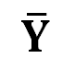
Boolean Algebra: Proving Things
Proving theorems via axioms of Boolean Algebra:
$$\overline{Y}$$
EX: Prove the theorem: X • Y + X • = X
X • ( Y + ) | = X | Distributive (5)
X • 1 | = X | Complement (6)
X | = X | Identity (4)
$$\overline{Y}$$
EX2: Prove the theorem: X + X • Y = X
X • 1 + X • Y | = X | Identity (4)
X • ( 1 + Y ) | = X | Distributive (5)
X • 1 | = X | Identity (2)
X | = X | Identity (4)

Slide 72
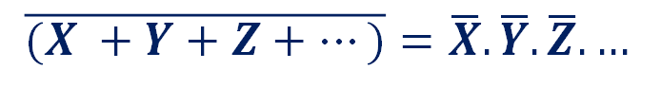

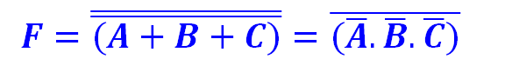
DeMorgan’s Law: Enabling Transformations
DeMorgan's Law:
12.
$$\overline{(X +Y+Z+…)}=\overline{X}.\overline{Y}.\overline{Z}. …$$
12D.
$$\overline{(X . Y.Z. …)}=\overline{X}+\overline{Y}+\overline{Z}+ …$$
Think of this as a transformation
Let’s say we have:
F = A + B + C
Applying DeMorgan’s Law (12), gives us
$$F=\overline{\overline{(A+B+C)}}=\overline{(\overline{A}.\overline{B}.\overline{C})}$$
At least one of A, B, C is TRUE --> It is not the case that A, B, C are all false

Slide 73




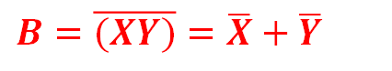

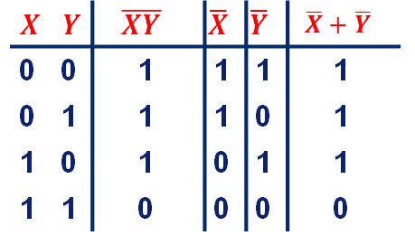
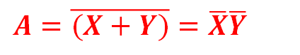






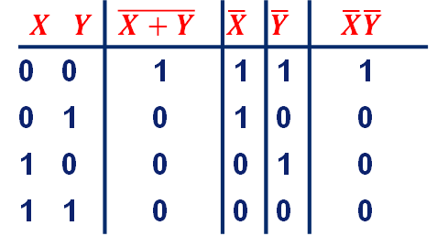


DeMorgan’s Law (Continued)
These are conversions between different types of logic functions
They can prove useful if you do not have every type of gate
$$A=\overline{(X+Y)}=\overline{X}\overline{Y}$$
$$X$$
$$A$$
$$Y$$
$$X$$ | $$Y$$ | $$\overline{X+Y}$$ | $$\overline{X}$$ | $$\overline{Y}$$ | $$\overline{X}\overline{Y}$$
0 | 0 | 1 | 1 | 1 | 1
0 | 1 | 0 | 1 | 0 | 0
1 | 0 | 0 | 0 | 1 | 0
1 | 1 | 0 | 0 | 0 | 0
NOR is equivalent to AND
with inputs complemented
$$X$$
$$A$$
$$Y$$
$$B=\overline{(XY)}=\overline{X}+\overline{Y}$$
$$X$$
$$B$$
$$X$$ | $$Y$$ | $$\overline{XY}$$ | $$\overline{X}$$ | $$\overline{Y}$$ | $$\overline{X}+\overline{Y}$$
0 | 0 | 1 | 1 | 1 | 1
0 | 1 | 1 | 1 | 0 | 1
1 | 0 | 1 | 0 | 1 | 1
1 | 1 | 0 | 0 | 0 | 0
$$Y$$
NAND is equivalent to OR
with inputs complemented
$$X$$
$$B$$
$$Y$$
Notes:
For some reason one type of gate might be much better than another one.
e.g., since pMOS transistors are slower, a NAND gate in CMOS is faster than a NOR gate in CMOS (all else being equal)

Slide 74
Digital Design & Computer Arch. Lecture 4: Combinational Logic I
Prof. Onur Mutlu
ETH Zürich
Spring 2020
28 February 2020

Slide 75
We Did Not Cover the Following Slides in Lecture 4

Slide 76
Using Boolean Equations to Represent a Logic Circuit

Slide 77
Sum of Products Form: Key Idea
Assume we have the truth table of a Boolean Function
How do we express the function in terms of the inputs in a standard manner?
Idea: Sum of Products form
Express the truth table as a two-level Boolean expression
that contains all input variable combinations that result in a 1 output
If ANY of the combinations of input variables that results in a 1 is TRUE, then the output is 1
F = OR of all input variable combinations that result in a 1

Slide 78
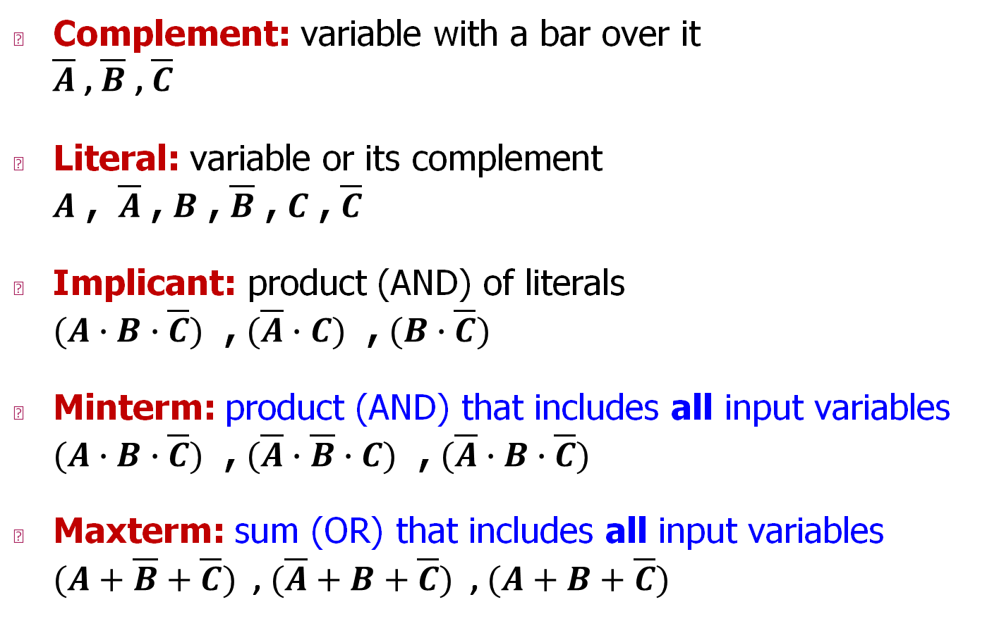
Some Definitions
Complement: variable with a bar over it $\overline{A}$ , $\overline{B}$ , $\overline{C}$
Literal: variable or its complement $A$ , $\overline{A}$ , $B$ , $\overline{B}$ , $C$ , $\overline{C}$
Implicant: product (AND) of literals $(A∙B∙\overline{C})$ , $(\overline{A}∙C)$ , $(B∙\overline{C})$
Minterm: product (AND) that includes all input variables $(A∙B∙\overline{C})$ , $(\overline{A}∙\overline{B}∙C)$ , $(\overline{A}∙B∙\overline{C})$
Maxterm: sum (OR) that includes all input variables $(A+\overline{B}+\overline{C})$ , $(\overline{A}+B+\overline{C})$ , $(A+B+\overline{C})$

Slide 79
Two-Level Canonical (Standard) Forms
Truth table is the unique signature of a Boolean function …
But, it is an expensive representation
A Boolean function can have many alternative Boolean expressions
i.e., many alternative Boolean expressions (and gate realizations) may have the same truth table (and function)
Canonical form: standard form for a Boolean expression
Provides a unique algebraic signature
If they all say the same thing, why do we care?
Different Boolean expressions lead to different gate realizations

Slide 80


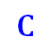

Two-Level Canonical Forms
Sum of Products Form (SOP)
Also known as disjunctive normal form or minterm expansion
$$A$$
$$B$$
$$C$$
$$F$$
0 | 0 | 0 | 0
0 | 0 | 1 | 0
0 | 1 | 0 | 0
0 | 1 | 1 | 1
1 | 0 | 0 | 1
1 | 0 | 1 | 1
1 | 1 | 0 | 1
1 | 1 | 1 | 1
0 1 1
1 0 0
1 0 1
1 1 0
1 1 1
$$F=\overline{A}BC + A\overline{B}\overline{C} + A\overline{B}C + AB\overline{C} + ABC$$
Each row in a truth table has a minterm
A minterm is a product (AND) of literals
Each minterm is TRUE for that row (and only that row)
All Boolean equations can be written in SOP form
Find all the input combinations (minterms) for which the output of the function is TRUE.

Slide 81

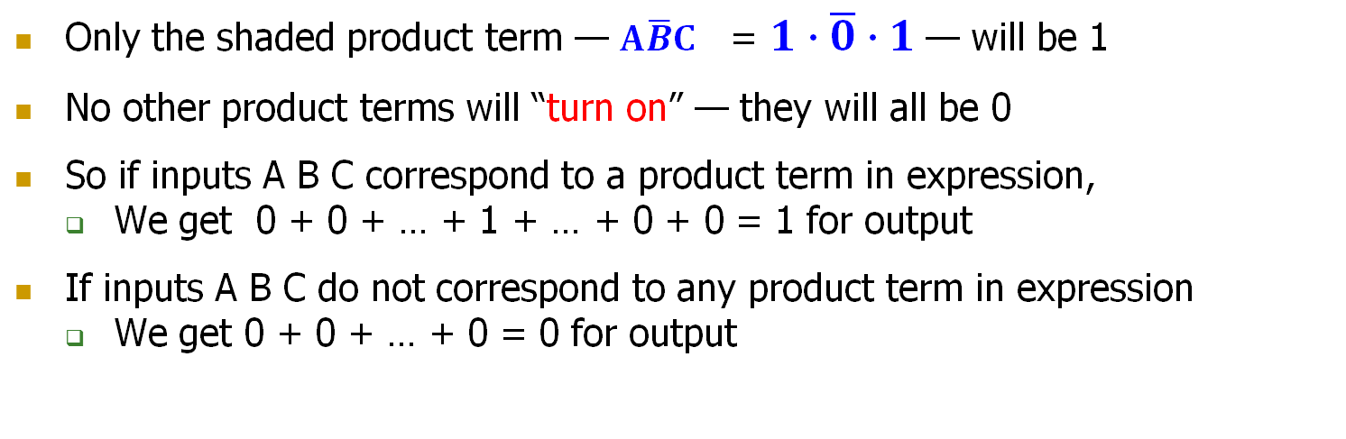
SOP Form — Why Does It Work?
This input
$$A$$
$$B$$
$$C$$
$$F$$
0 1 1
1 0 0
1 0 1
1 1 0
1 1 1
0 | 0 | 0 | 0
0 | 0 | 1 | 0
0 | 1 | 0 | 0
0 | 1 | 1 | 1
1 | 0 | 0 | 1
1 | 0 | 1 | 1
1 | 1 | 0 | 1
1 | 1 | 1 | 1
$$F=\overline{A}BC + A\overline{B}\overline{C} + A\overline{B}C + AB\overline{C} + ABC$$
Activates
this term
Only the shaded product term — $A\overline{B}C$ = $1∙\overline{0}∙1$— will be 1
No other product terms will “turn on” — they will all be 0
So if inputs A B C correspond to a product term in expression,
We get 0 + 0 + … + 1 + … + 0 + 0 = 1 for output
If inputs A B C do not correspond to any product term in expression
We get 0 + 0 + … + 0 = 0 for output

Slide 82
Aside: Notation for SOP
Standard “shorthand” notation
If we agree on the order of the variables in the rows of truth table…
then we can enumerate each row with the decimal number that corresponds to the binary number created by the input pattern
$$A$$
$$B$$
$$C$$
$$F$$
0 0 0 0
0 0 1 0
0 1 0 0
0 1 1 1
1 0 0 1
1 0 1 1
1 1 0 1
1 1 1 1
100 = decimal 4 so this is minterm #4, or m4
111 = decimal 7 so this is minterm #7, or m7
f =
We can write this as a sum of products
m3 + m4 + m5 + m6 + m7
= ∑m(3,4,5,6,7)
Or, we can use a summation notation

Slide 83
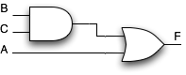
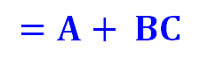


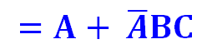
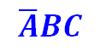

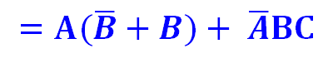

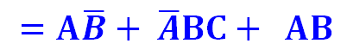

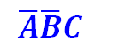
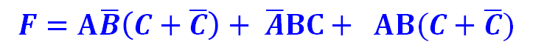


Canonical SOP Forms
$$A$$
$$B$$
$$C$$
minterms
0 0 0 = m0
0 0 1 = m1
0 1 0 = m2
0 1 1 = m3
1 0 0 = m4
1 0 1 = m5
1 1 0 = m6
1 1 1 = m7
F in canonical form:
$$\overline{A}\overline{B}\overline{C}$$
$$\overline{A}\overline{B}C$$
F(A,B,C) = ∑m(3,4,5,6,7)
$$\overline{A}B\overline{C}$$
= m3 + m4 + m5 + m6 + m7
$$\overline{A}BC$$
$$A\overline{B}\overline{C}$$
$$F=\overline{A}BC + A\overline{B}\overline{C}$$
$+ A\overline{B}C + AB\overline{C} + ABC$
$$A\overline{B}C$$
$$AB\overline{C}$$
$$ABC$$
canonical form ≠ minimal form
Shorthand Notation for
Minterms of 3 Variables
$$F=A\overline{B}\left(C+\overline{C}\right)+ \overline{A}BC+ AB(C+\overline{C})$$
$$=A\overline{B}+ \overline{A}BC+ AB$$
$$=A(\overline{B}+B)+ \overline{A}BC$$
$$=A+ \overline{A}BC$$
2-Level AND/OR
Realization
$$=A+ BC$$

Slide 84

From Logic to Gates
SOP (sum-of-products) leads to two-level logic
Example: $Y=\left(\overline{A}∙\overline{B}∙\overline{C}\right)+\left(A∙\overline{B}∙\overline{C}\right)+\left(A∙\overline{B}∙C\right)$

Slide 85

Alternative Canonical Form: POS
We can have another from of representation
DeMorgan of SOP of $\overline{F}$
A product of sums (POS)
products
$$F=(A+B+C)(A+B+\overline{C})(A+\overline{B}+C)$$
Each sum term represents one of the “zeros” of the function
sums
This input
0 0 0
0 0 1
0 1 0
$$A$$
$$B$$
$$C$$
$$F$$
$$F=\left(A+B+C\right) \left(A+B+\overline{C}\right) (A+\overline{B}+C)$$
0 | 0 | 0 | 0
0 | 0 | 1 | 0
0 | 1 | 0 | 0
0 | 1 | 1 | 1
1 | 0 | 0 | 1
1 | 0 | 1 | 1
1 | 1 | 0 | 1
1 | 1 | 1 | 1
Activates this term
For the given input, only the shaded sum term will equal 0
Anything ANDed with 0 is 0; Output F will be 0
$$A+\overline{B}+C=0+\overline{1}+0$$

Slide 86











Consider A=0, B=1, C=0
Input
$$A$$
$$B$$
$$C$$
$$F$$
0 1 0
$$F=(A+B+C)(A+B+\overline{C})(A+\overline{B}+C)$$
0 | 0 | 0 | 0
0 | 0 | 1 | 0
0 | 1 | 0 | 0
0 | 1 | 1 | 1
1 | 0 | 0 | 1
1 | 0 | 1 | 1
1 | 1 | 0 | 1
1 | 1 | 1 | 1
$$0 1 0$$
$$0 1 \overline{0}$$
$$0 \overline{1} 0$$
1
1
0
$$F=0$$
Only one of the products will be 0, anything ANDed with 0 is 0
Therefore, the output is F = 0

Slide 87





POS: How to Write It
$$A$$
$$B$$
$$C$$
$$F$$
$$F=(A+B+C)(A+B+\overline{C})(A+\overline{B}+C)$$
0 | 0 | 0 | 0
0 | 0 | 1 | 0
0 | 1 | 0 | 0
0 | 1 | 1 | 1
1 | 0 | 0 | 1
1 | 0 | 1 | 1
1 | 1 | 0 | 1
1 | 1 | 1 | 1
$$A$$
$$\overline{B}$$
$$C$$
$$A + \overline{B} + C$$
Maxterm form:
1. Find truth table rows where F is 0
2. 0 in input col ➙ true literal
3. 1 in input col ➙ complemented literal
4. OR the literals to get a Maxterm
5. AND together all the Maxterms
Or just remember, POS of $F$ is the same as the DeMorgan of SOP of $\overline{F}$ !!

Slide 88











Canonical POS Forms
Product of Sums / Conjunctive Normal Form / Maxterm Expansion
$$F=(A+B+C)(A+B+\overline{C})(A+\overline{B}+C)$$
$$\prod{M(0,1,2)}$$
$$A$$
$$B$$
$$C$$
Maxterms
0 0 0 = M0
0 0 1 = M1
0 1 0 = M2
0 1 1 = M3
1 0 0 = M4
1 0 1 = M5
1 1 0 = M6
1 1 1 = M7
$$A+B+C$$
$$A+B+\overline{C}$$
$$A$$
$$B$$
$$C$$
$$F$$
$$A+\overline{B}+C$$
0 | 0 | 0 | 0
0 | 0 | 1 | 0
0 | 1 | 0 | 0
0 | 1 | 1 | 1
1 | 0 | 0 | 1
1 | 0 | 1 | 1
1 | 1 | 0 | 1
1 | 1 | 1 | 1
Note that you form the maxterms around the “zeros” of the function
This is not the complement of the function!
$$A+\overline{B}+\overline{C}$$
$$\overline{A}+B+C$$
$$\overline{A}+B+\overline{C}$$
$$\overline{A}+\overline{B}+C$$
$$\overline{A}+\overline{B}+\overline{C}$$
Maxterm shorthand notation
for a function of three variables

Slide 89















Useful Conversions
1.
Minterm to Maxterm conversion:
rewrite minterm shorthand using maxterm shorthand
replace minterm indices with the indices not already used
E.g., $F\left(A,B,C\right)=\sum{m\left(3,4,5,6,7\right)=\prod{M(0,1,2)}}$
2.
Maxterm to Minterm conversion:
rewrite maxterm shorthand using minterm shorthand
replace maxterm indices with the indices not already used
E.g., $F\left(A,B,C\right)=\prod{M(0,1,2)}=\sum{m\left(3,4,5,6,7\right)}$
3.
$$F$$
$$\overline{F}$$
Expansion of to expansion of :
$$E.g., F\left(A,B,C\right)=\sum{m\left(3,4,5,6,7\right)}$$
$$\overline{F}\left(A,B,C\right)=\sum{m(0,1,2)}$$
$$=\prod{M(0,1,2)}$$
$$=\prod{M\left(3,4,5,6,7\right)}$$
4.
$$F$$
$$\overline{F}$$
Minterm expansion of to Maxterm expansion of :
$$F$$
rewrite in Maxterm form, using the same indices as
$$E.g., F\left(A,B,C\right)=\sum{m\left(3,4,5,6,7\right)}$$
$\overline{F}\left(A,B,C\right)$ $=\prod{M\left(3,4,5,6,7\right)}$
$$=\prod{M(0,1,2)}$$
$$=\sum{m(0,1,2)}$$

Slide 90
Combinational Building Blocks used in Modern Computers

Slide 91
Combinational Building Blocks
Combinational logic is often grouped into larger building blocks to build more complex systems
Hides the unnecessary gate-level details to emphasize the function of the building block
We now look at:
Decoders
Multiplexers
Full adder
PLA (Programmable Logic Array)

Slide 92
Decoder
n inputs and 2^{n} outputs
Exactly one of the outputs is 1 and all the rest are 0s
The one output that is logically 1 is the output corresponding to the input pattern that the logic circuit is expected to detect

Slide 93
Decoder
The decoder is useful in determining how to interpret a bit pattern
It could be the address of a row in DRAM, that the processor intends to read from
It could be an instruction in the program and the processor has to decide what action to do! (based on instruction opcode)

Slide 94
Multiplexer (MUX), or Selector
Selects one of the N inputs to connect it to the output
Needs log₂N-bit control input
2:1 MUX

Slide 95
Multiplexer (MUX)
The output C is always connected to either the input A or the input B
Output value depends on the value of the select line S
Your task: Draw the schematic for an 8-input (8:1) MUX
Gate level: as a combination of basic AND, OR, NOT gates
Module level: As a combination of 2-input (2:1) MUXes

Slide 96




Full Adder (I)
Binary addition
Similar to decimal addition
From right to left
One column at a time
One sum and one carry bit
Truth table of binary addition on one column of bits within two n-bit operands
$$a_{n−1}a_{n−2}…a_{1}a_{0}$$
$$b_{n−1}b_{n−2}…b_{1}b_{0}$$
$$C_{n} C_{n−1} … C_{1}$$
$$S_{n−1} … S_{1}S_{0}$$

Slide 97

Full Adder (II)
Binary addition
N 1-bit additions
SOP of 1-bit addition
$$a_{n−1}a_{n−2}…a_{1}a_{0}$$
$$b_{n−1}b_{n−2}…b_{1}b_{0}$$
Full Adder (1 bit)
Full Adder
$$C_{n} C_{n−1} … C_{1}$$
$$S_{n−1} … S_{1}S_{0}$$

Slide 98








4-Bit Adder from Full Adders
Creating a 4-bit adder out of 1-bit full adders
To add two 4-bit binary numbers A and B
$$a_{3} a_{2} a_{1} a_{0}$$
$$1_{} 0_{} 1_{} 1_{}$$
+
+
$$b_{3} { b}_{2} b_{1} b_{0}$$
$$1_{} { 0}_{} 0_{} 1_{}$$
$$c_{4} c_{3} c_{2} c_{1}$$
$$1_{} 0_{} 1_{} 1_{}$$
$$s_{3} s_{2} s_{1} s_{0}$$
$$0_{} 1_{} 0_{} 0_{}$$

Slide 99
The Programmable Logic Array (PLA)
The below logic structure is a very common building block for implementing any collection of logic functions one wishes to
An array of AND gates followed by an array of OR gates
How do we determine the number of AND gates?
Remember SOP: the number of possible minterms
For an n-input logic function, we need a PLA with 2^{n} n-input AND gates
How do we determine the number of OR gates? The number of output columns in the truth table

Slide 100
The Programmable Logic Array (PLA)
How do we implement a logic function?
Connect the output of an AND gate to the input of an OR gate if the corresponding minterm is included in the SOP
This is a simple programmable logic
Programming a PLA: we program the connections from AND gate outputs to OR gate inputs to implement a desired logic function
Have you seen any other type of programmable logic?
Yes! An FPGA…
An FPGA uses more advanced structures, as we saw in Lecture 3

Slide 101
Implementing a Full Adder Using a PLA
This input should not be
connected to any outputs
We do not need
this output
Truth table of a full adder

Slide 102
Logical (Functional) Completeness
Any logic function we wish to implement could be accomplished with a PLA
PLA consists of only AND gates, OR gates, and inverters
We just have to program connections based on SOP of the intended logic function
The set of gates {AND, OR, NOT} is logically complete because we can build a circuit to carry out the specification of any truth table we wish, without using any other kind of gate
NAND is also logically complete. So is NOR.
Your task: Prove this.

Slide 103
More Combinational Building Blocks
H&H Chapter 2 in full
Required Reading
E.g., see Tri-state Buffer and Z values in Section 2.6
H&H Chapter 5
Will be required reading soon.
You will benefit greatly by reading the “combinational” parts of Chapter 5 soon.
Sections 5.1 and 5.2

Slide 104
Tri-State Buffer
A tri-state buffer enables gating of different signals onto a wire
Floating signal (Z): Signal that is not driven by any circuit
Open circuit, floating wire

Slide 105
Example: Use of Tri-State Buffers
Imagine a wire connecting the CPU and memory
At any time only the CPU or the memory can place a value on the wire, both not both
You can have two tri-state buffers: one driven by CPU, the other memory; and ensure at most one is enabled at any time

Slide 106
Example Design with Tri-State Buffers
GateCPU
CPU
GateMem
Memory
Shared Bus

Slide 107
Logic Simplification: Karnaugh Maps (K-Maps)

Slide 108
Recall: Full Adder in SOP Form Logic
Full Adder

Slide 109
Goal: Simplified Full Adder
How do we simplify Boolean logic?

Slide 110
Quick Recap on Logic Simplification
The original Boolean expression (i.e., logic circuit) may not be optimal
Can we reduce a given Boolean expression to an equivalent expression with fewer terms?
The goal of logic simplification:
Reduce the number of gates/inputs
Reduce implementation cost
F = ~A(A + B) + (B + AA)(A + ~B)
F = A + B
A basis for what the automated design tools are doing today

Slide 111






Logic Simplification
Systematic techniques for simplifications
amenable to automation
$$F= A\overline{B}+AB$$
Key Tool: The Uniting Theorem —
$F=$
$$A\overline{B}+AB=A\left(\overline{B}+B\right)=A\left(1\right)=A$$
Essence of Simplification:
Find two element subsets of the ON-set where only one variable changes its value. This single varying variable can be eliminated!
B's value changes within the rows where F==1 (“ON set”)
A's value does NOT change within the ON-set rows
If an input (B) can change without changing the output, that input value is not needed
➙ B is eliminated, A remains
$G=$
$\overline{A}\overline{B}+A\overline{B}=\left(\overline{A}+A\right)\overline{B}=\overline{B}$
B's value stays the same within the ON-set rows
A's value changes within the ON-set rows
➙ A is eliminated, B remains

Slide 112
Complex Cases
One example
Problem
Easy to see how to apply Uniting Theorem…
Hard to know if you applied it in all the right places…
…especially in a function of many more variables
Question
Is there an easier way to find potential simplifications?
i.e., potential applications of Uniting Theorem…?
Answer
Need an intrinsically geometric representation for Boolean f( )
Something we can draw, see…
$$Cout=\overline{A}BC+A\overline{B}C+AB\overline{C}+ABC$$

Slide 113






Karnaugh Map
Karnaugh Map (K-map) method
K-map is an alternative method of representing the truth table that helps visualize adjacencies in up to 6 dimensions
Physical adjacency ↔ Logical adjacency
 |  | 0 | 1
0 |  | 00 | 01
1 |  | 10 | 11
 |  | 00 | 01 | 11 | 10
0 |  | 000 | 001 | 011 | 010
1 |  | 100 | 101 | 111 | 110
 |  | 00 | 01 | 11 | 10
00 |  | 0000 | 0001 | 0011 | 0010
01 |  | 0100 | 0101 | 0111 | 0110
11 |  | 1100 | 1101 | 1111 | 1110
10 |  | 1000 | 1001 | 1011 | 1010
2-variable K-map
3-variable K-map
4-variable K-map
$$B$$
$$BC$$
$$CD$$
$$A$$
$$AB$$
$$A$$
Numbering Scheme: 00, 01, 11, 10 is called a
“Gray Code” — only a single bit (variable) changes
from one code word and the next code word

Slide 114

Karnaugh Map Methods
Adjacent
 |  | 00 | 01 | 11 | 10
0 |  | 000 | 001 | 011 | 010
1 |  | 100 | 101 | 111 | 110
$$BC$$
$$A$$
000
010
110
100
001
011
111
101
000
010
110
100
001
011
111
101
Adjacent
K-map adjacencies go “around the edges”
Wrap around from first to last column
Wrap around from top row to bottom row

Slide 115







K-map Cover - 4 Input Variables
 |  | 00 | 01 | 11 | 10
00 |  | 1 | 0 | 0 | 1
01 |  | 0 | 1 | 0 | 0
11 |  | 1 | 1 | 1 | 1
10 |  | 1 | 1 | 1 | 1
$$F(A,B,C,D)=\sum{m(0,2,5,8,9,10,11,12,13,14,15)}$$
$$CD$$
$$AB$$
$$A+\overline{B}\overline{D}+B\overline{C}D$$
$$F=$$
$$A$$
$$A+\overline{B}\overline{D}$$
Strategy for “circling” rectangles on Kmap:
As big as possible
Biggest “oops!” that people forget:
Wrap-arounds

Slide 116






Example: As Logic Gates
What does this solution look like as gates?
$$B\overline{C}D+A+\overline{B}\overline{D}$$
$$A$$
$$\overline{C}$$
$$B$$
$$D$$
$$\overline{B}$$
$$\overline{D}$$

Slide 117
Logic Minimization Using K-Maps
Very simple guideline:
Circle all the rectangular blocks of 1’s in the map, using the fewest possible number of circles
Each circle should be as large as possible
Read off the implicants that were circled
More formally:
A Boolean equation is minimized when it is written as a sum of the fewest number of prime implicants
Each circle on the K-map represents an implicant
The largest possible circles are prime implicants

Slide 118

K-map Rules
What can be legally combined (circled) in the K-map?
Rectangular groups of size 2^{k} for any integer k
Each cell has the same value (1, for now)
All values must be adjacent
Wrap-around edge is okay
How does a group become a term in an expression?
Determine which literals are constant, and which vary across group
Eliminate varying literals, then AND the constant literals
constant 1 ➙ use $X$, constant 0 ➙ use $\overline{X}$
What is a good solution?
Biggest groupings ➙ eliminate more variables (literals) in each term
Fewest groupings ➙ fewer terms (gates) all together
OR together all AND terms you create from individual groups

Slide 119
K-map Example: Two-bit Comparator
A | B | C | D | F1 | F2 | F3
0 | 0 | 0 | 0 | 1 | 0 | 0
0 | 0 | 0 | 1 | 0 | 1 | 0
0 | 0 | 1 | 0 | 0 | 1 | 0
0 | 0 | 1 | 1 | 0 | 1 | 0
0 | 1 | 0 | 0 | 0 | 0 | 1
0 | 1 | 0 | 1 | 1 | 0 | 0
0 | 1 | 1 | 0 | 0 | 1 | 0
0 | 1 | 1 | 1 | 0 | 1 | 0
1 | 0 | 0 | 0 | 0 | 0 | 1
1 | 0 | 0 | 1 | 0 | 0 | 1
1 | 0 | 1 | 0 | 1 | 0 | 0
1 | 0 | 1 | 1 | 0 | 1 | 0
1 | 1 | 0 | 0 | 0 | 0 | 1
1 | 1 | 0 | 1 | 0 | 0 | 1
1 | 1 | 1 | 0 | 0 | 0 | 1
1 | 1 | 1 | 1 | 1 | 0 | 0
 | A
 |  | F1 | AB = CD
 | B
 |  | F2 | AB < CD
 | C
 |  | F3 | AB > CD
 | D
Design Approach:
Write a 4-Variable K-map
for each of the 3
output functions

Slide 120






K-map Example: Two-bit Comparator (2)
 |  | 00 | 01 | 11 | 10
00 |  | 1
01 |  |  | 1
11 |  |  |  | 1
10 |  |  |  |  | 1
K-map for F1
A | B | C | D | F1 | F2 | F3
0 | 0 | 0 | 0 | 1 | 0 | 0
0 | 0 | 0 | 1 | 0 | 1 | 0
0 | 0 | 1 | 0 | 0 | 1 | 0
0 | 0 | 1 | 1 | 0 | 1 | 0
0 | 1 | 0 | 0 | 0 | 0 | 1
0 | 1 | 0 | 1 | 1 | 0 | 0
0 | 1 | 1 | 0 | 0 | 1 | 0
0 | 1 | 1 | 1 | 0 | 1 | 0
1 | 0 | 0 | 0 | 0 | 0 | 1
1 | 0 | 0 | 1 | 0 | 0 | 1
1 | 0 | 1 | 0 | 1 | 0 | 0
1 | 0 | 1 | 1 | 0 | 1 | 0
1 | 1 | 0 | 0 | 0 | 0 | 1
1 | 1 | 0 | 1 | 0 | 0 | 1
1 | 1 | 1 | 0 | 0 | 0 | 1
1 | 1 | 1 | 1 | 1 | 0 | 0
$$C$$
$$CD$$
$$AB$$
$$B$$
$$A$$
$$D$$
F1 =
A'B'C'D' + A'BC'D + ABCD + AB'CD'

Slide 121



K-map Example: Two-bit Comparator (3)
 |  | 00 | 01 | 11 | 10
00 |  |  | 1 | 1 | 1
01 |  |  |  | 1 | 1
11
10 |  |  |  | 1
K-map for F2
A | B | C | D | F1 | F2 | F3
0 | 0 | 0 | 0 | 1 | 0 | 0
0 | 0 | 0 | 1 | 0 | 1 | 0
0 | 0 | 1 | 0 | 0 | 1 | 0
0 | 0 | 1 | 1 | 0 | 1 | 0
0 | 1 | 0 | 0 | 0 | 0 | 1
0 | 1 | 0 | 1 | 1 | 0 | 0
0 | 1 | 1 | 0 | 0 | 1 | 0
0 | 1 | 1 | 1 | 0 | 1 | 0
1 | 0 | 0 | 0 | 0 | 0 | 1
1 | 0 | 0 | 1 | 0 | 0 | 1
1 | 0 | 1 | 0 | 1 | 0 | 0
1 | 0 | 1 | 1 | 0 | 1 | 0
1 | 1 | 0 | 0 | 0 | 0 | 1
1 | 1 | 0 | 1 | 0 | 0 | 1
1 | 1 | 1 | 0 | 0 | 0 | 1
1 | 1 | 1 | 1 | 1 | 0 | 0
$$C$$
$$CD$$
$$AB$$
$$B$$
$$A$$
$$D$$
F2 =
A'C + A'B'D + B'CD
F3 =
? (Exercise for you)

Slide 122
K-maps with “Don’t Care”
Don’t Care really means I don’t care what my circuit outputs if this appears as input
You have an engineering choice to use DON’T CARE patterns intelligently as 1 or 0 to better simplify the circuit
A | B | C | D | F | G
• • •
0 | 1 | 1 | 0 | X | X
0 | 1 | 1 | 1
1 | 0 | 0 | 0 | X | X
1 | 0 | 0 | 1
• • •
I can pick 00, 01, 10, 11
independently of below
I can pick 00, 01, 10, 11
independently of above

Slide 123
Example: BCD Increment Function
BCD (Binary Coded Decimal) digits
Encode decimal digits 0 - 9 with bit patterns 0000₂ — 1001₂
When incremented, the decimal sequence is 0, 1, …, 8, 9, 0, 1
A | B | C | D | W | X | Y | Z
0 | 0 | 0 | 0 | 0 | 0 | 0 | 1
0 | 0 | 0 | 1 | 0 | 0 | 1 | 0
0 | 0 | 1 | 0 | 0 | 0 | 1 | 1
0 | 0 | 1 | 1 | 0 | 1 | 0 | 0
0 | 1 | 0 | 0 | 0 | 1 | 0 | 1
0 | 1 | 0 | 1 | 0 | 1 | 1 | 0
0 | 1 | 1 | 0 | 0 | 1 | 1 | 1
0 | 1 | 1 | 1 | 1 | 0 | 0 | 0
1 | 0 | 0 | 0 | 1 | 0 | 0 | 1
1 | 0 | 0 | 1 | 0 | 0 | 0 | 0
1 | 0 | 1 | 0 | X | X | X | X
1 | 0 | 1 | 1 | X | X | X | X
1 | 1 | 0 | 0 | X | X | X | X
1 | 1 | 0 | 1 | X | X | X | X
1 | 1 | 1 | 0 | X | X | X | X
1 | 1 | 1 | 1 | X | X | X | X
These input patterns should
never be encountered in practice
(hey -- it’s a BCD number!)
So, associated output values are
“Don’t Cares”

Slide 124






K-map for BCD Increment Function
Z (without don’t cares) = A'D' + B'C'D’
Z (with don’t cares) = D'
W
 |  | 00 | 01 | 11 | 10
00
01 |  |  |  | 1
11 |  | X | X | X | X
10 |  | 1 |  | X | X
X
 |  | 00 | 01 | 11 | 10
00 |  |  |  | 1
01 |  | 1 | 1 |  | 1
11 |  | X | X | X | X
10 |  |  |  | X | X
$$CD$$
$$CD$$
A B C D
+ 1
W X Y Z
$$AB$$
$$AB$$
Y
 |  | 00 | 01 | 11 | 10
00 |  |  | 1 |  | 1
01 |  |  | 1 |  | 1
11 |  | X | X | X | X
10 |  |  |  | X | X
Z
 |  | 00 | 01 | 11 | 10
00 |  | 1 |  |  | 1
01 |  | 1 |  |  | 1
11 |  | X | X | X | X
10 |  | 1 |  | X | X
$$CD$$
$$C$$
$$CD$$
$$AB$$
$$AB$$
$$B$$
$$A$$
$$D$$

Slide 125
K-map Summary
Karnaugh maps as a formal systematic approach for logic simplification
2-, 3-, 4-variable K-maps
K-maps with “Don’t Care” outputs
H&H Section 2.7

Slide 126
Digital Design & Computer Arch. Lecture 4: Combinational Logic I
Prof. Onur Mutlu
ETH Zürich
Spring 2020
28 February 2020

